Slide 1


Parsing PCAP File and uploading to HDFS.
Done by: Sumanth Uppala,
Instructor: Dr. Feng Yu.

Slide 2
Out line
Setting up the login server on VM.
Parsing PCAP file.
Uploading parsed PCAP file into HDFS

Slide 3
Requirements
Spark (Hadoop).
HDFS.
JAVA.
SSH (Putty).

Slide 4
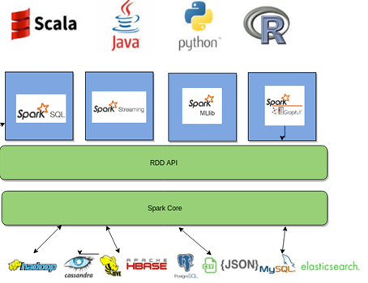
Spark
Spark is a open source and Cluster-computing framework. It has an interface with fault tolerance and implicit parallelism.
Spark → Map reduce
1. Processing very big sets
2. Processing time gets decreases

Slide 5
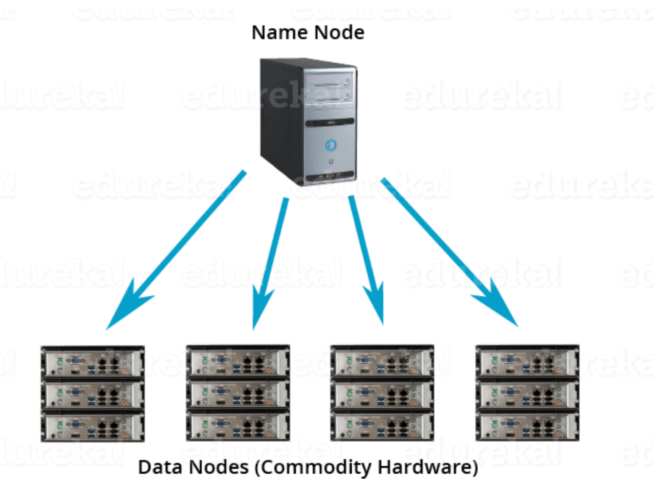
HDFS
It is a Block file system where file is divided into blocks with pre-determined size.
All these blocks will be stored over a group of one or more machines.
It follows master slave architecture.
One node acts as a master and rest of the nodes in a cluster acts as Data nodes (Slaves).

Slide 6
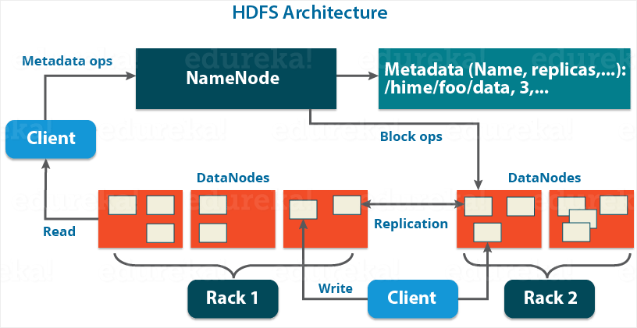
HDFS Architecture
Name Node
Data Node
Secondary Name Node
HDFS → Hadoop(Map Reduce) d f s
1. Availability
2. Scalability

Slide 7
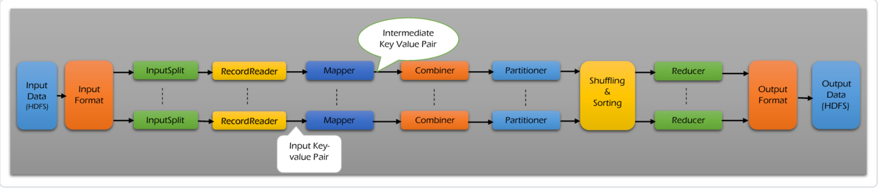
Map Reduce
Input Files
Input Format
Input Split
Partitioner
Shuffling and Sorting
Reducer
Output Format
Map Reduce → Core component of Hadoop which provides data processing.
Map Reduce:
Map → packet → csv
Reduce → sorting according to timestamp

Slide 8
Input format
PCAPinputformat decodes to LongWritable, ObjectWritable
ObjectWritable → contains the Packet
PCAP line → Key, Value
Key → Timestamp
Value → Line

Slide 9
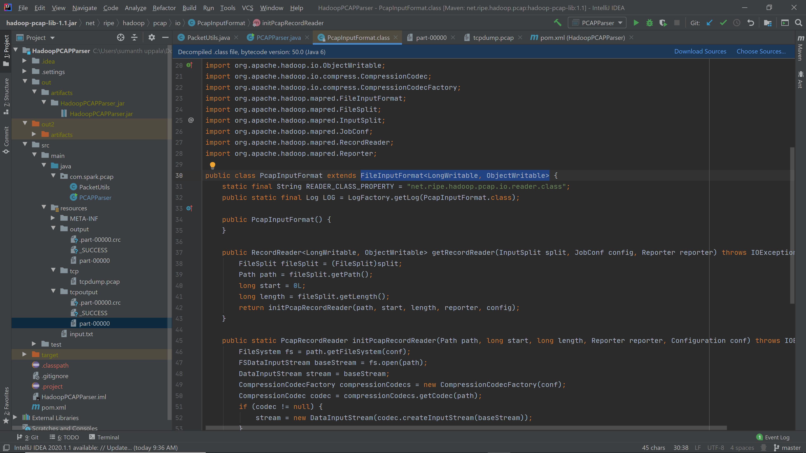
Input format class

Slide 10
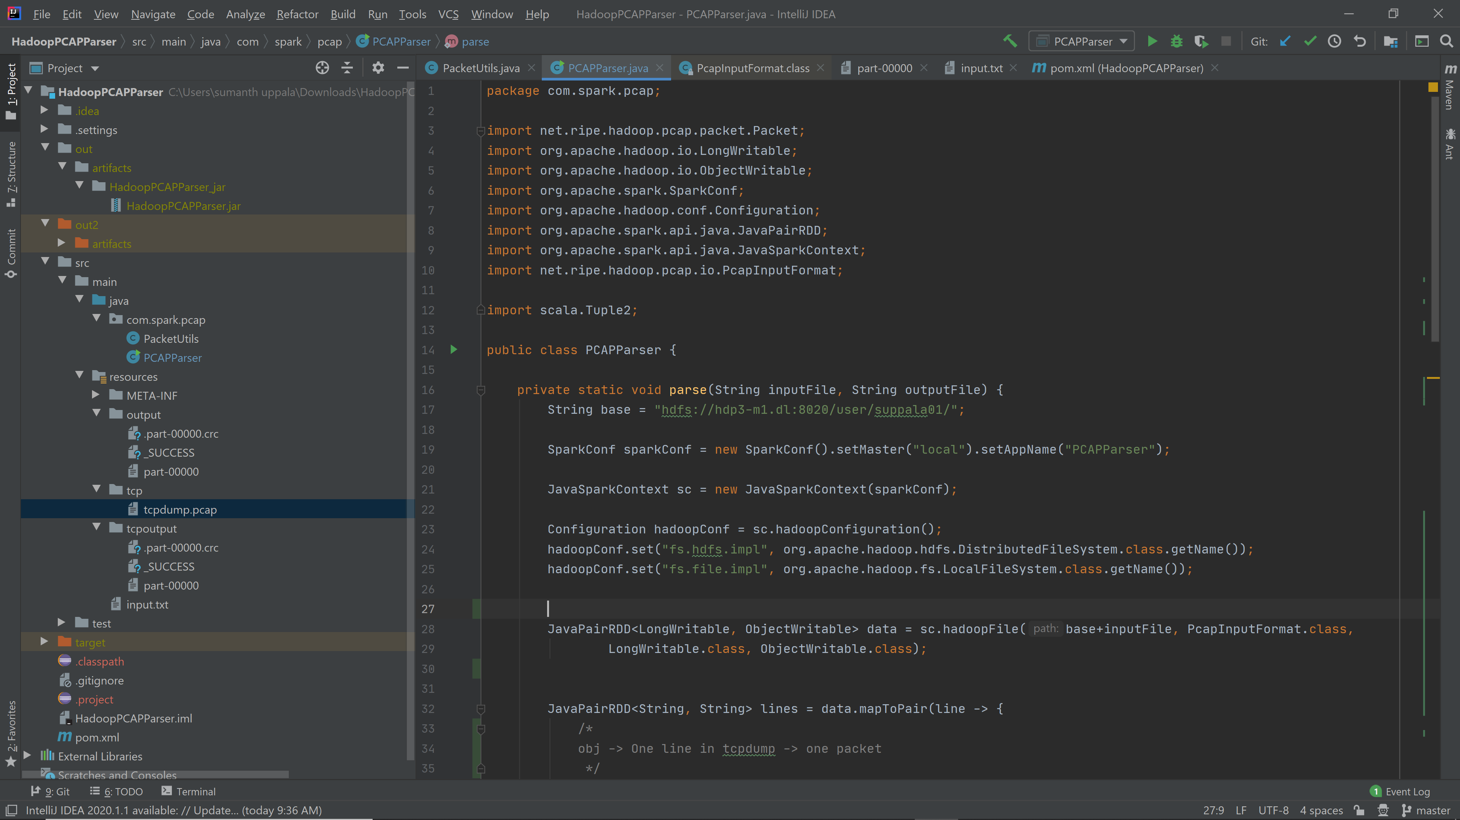
PCAP Parser code

Slide 11
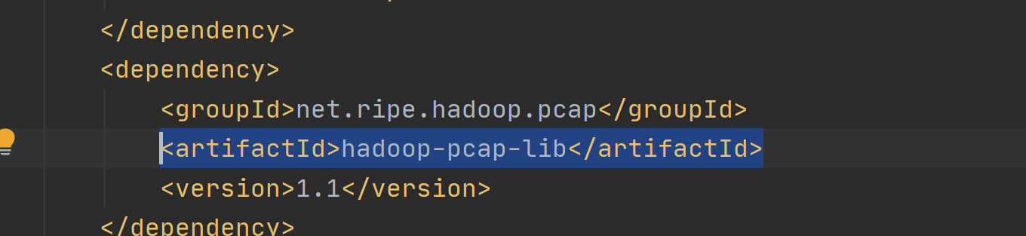
TCP Dump Parsing
1. JNetPCAP library in java. Lib files are needed for parsing tcp dump files
2. Hadoop-PCAP-lib. It doesn't need any additional libraries.
Java level parsing
Translates packet from tcp dump to a java understandable Packet class

Slide 12
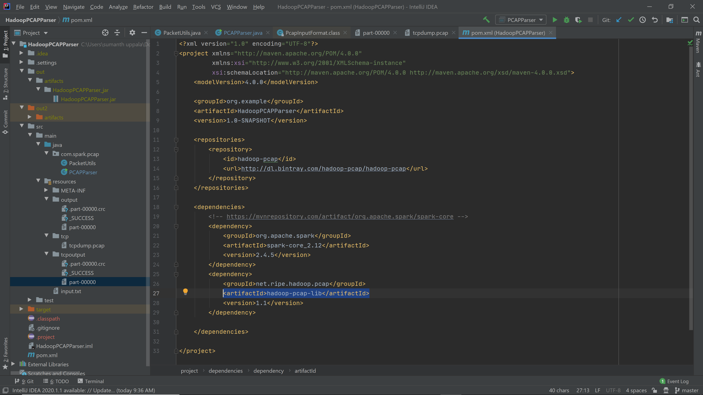
Hadoop PCAP Parser

Slide 13
Key, Value
1.PCAP line → Key, Value
Key → Timestamp
Value → Line
2.Packet → key, value
key → timestamp
value → output csv

Slide 14
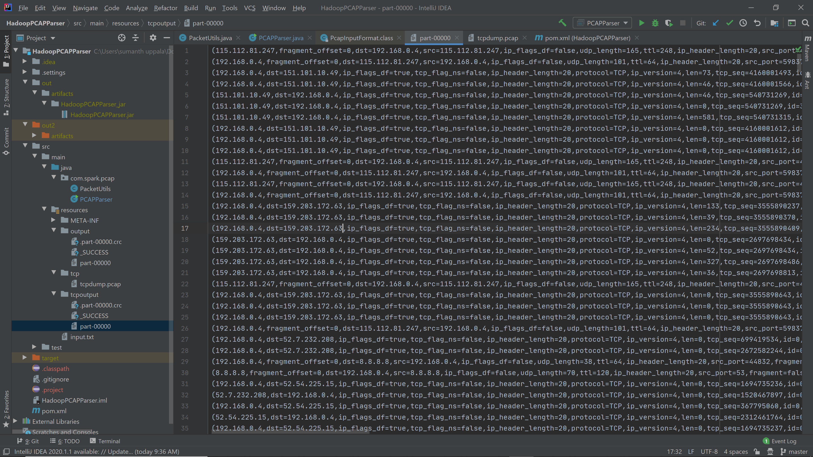
Output (CSV format)

Slide 15

Mail ID: suppala01@student.ysu.edu
GitHub Repo: https://github.com/sumanthuppala/HadoopPCAPParser
Thank you

